Slide 1
Exploring the bitcoin cryptocurrency

Slide 2
Team Details
B.Lakshmi Sravya(TL)
D.Gayatri
D.Devika
P.Sai Krupakar Reddy
S.Aravind

Slide 3
What is the project about?
To know the causes of the sudden spikes and dips in cryptocurrency values?
To know whether the market for different altcoins inseparably linked or largely independent?
To know how we can predict what will happen next?

Slide 4
What are we predicting?
We are predicting the model by performing Regression operations on different inputs with different ratios gives different accuracies.

Slide 5
Features
H24_volume_usd
Availabel_supply
Last_updated
Percent_change_1h
Percent_change_24h
Percent_change_7d
Price_btc
Price_usd

Slide 6
Output
Market-cap_usd
Total_supply

Slide 7
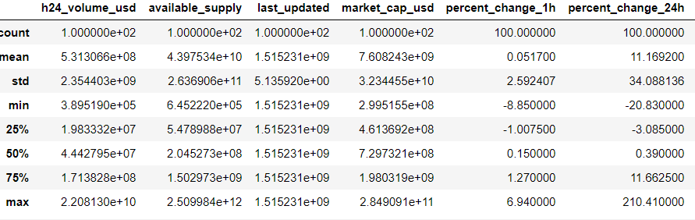
Technical Description
Describe():This method describes about the dataset.

Slide 8
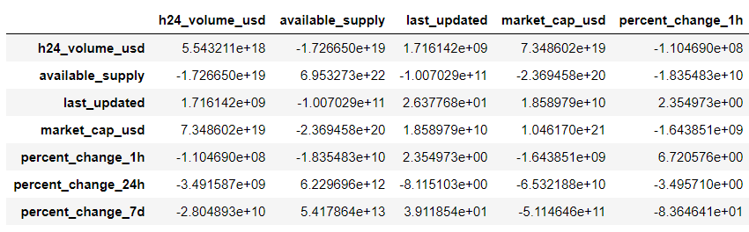
Covariance():It is the measure of relationship between two random variables.

Slide 9
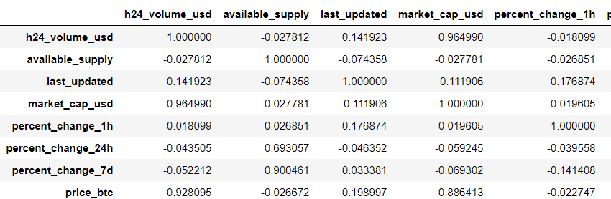
Corr():It measures the relationship between variables.

Slide 10
Visualizations
Boxplot()
Hist()
Pairplot()
Regplot()
Scatterplot
Heatmap
Notes:
Boxplot()
Hist()
Pairplot()
Regplot()
Scatterplot
Heatmap

Slide 11
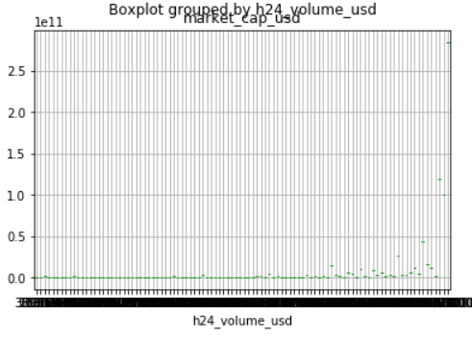
Boxplot(): This method for graphically depicting groups of numerical data through their quartiles.

Slide 12
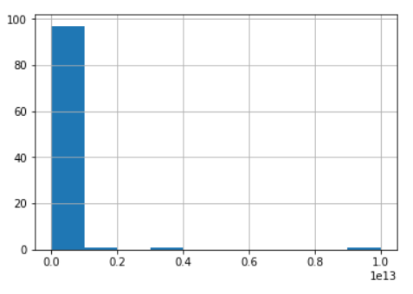
Hist(): histplot function to plot a polygon frequency chart.

Slide 13
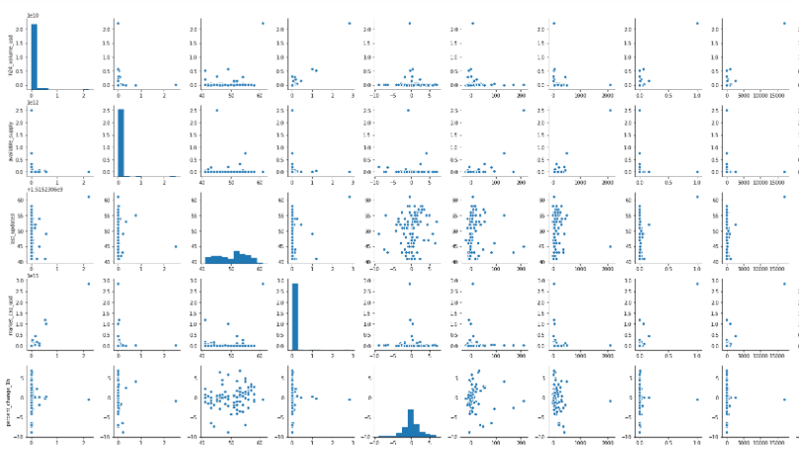
Pairplot(): This function will create a grid of Axes such that each variable in data will by shared in the y-axis across a single row and in the x-axis across a single column.

Slide 14
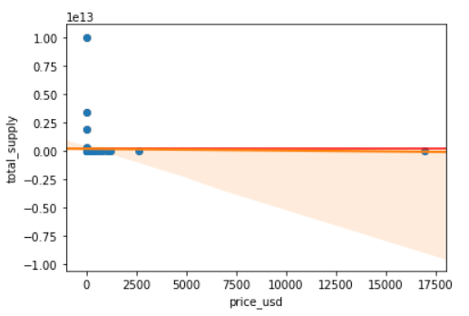
Regplot():This is a axis level function

Slide 15
These are some of the meanplots

Slide 16
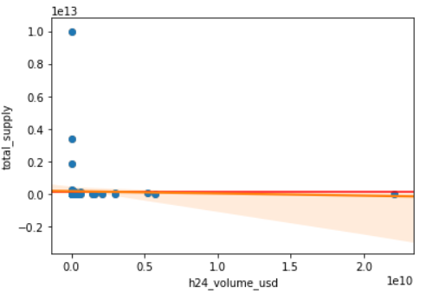

Slide 17
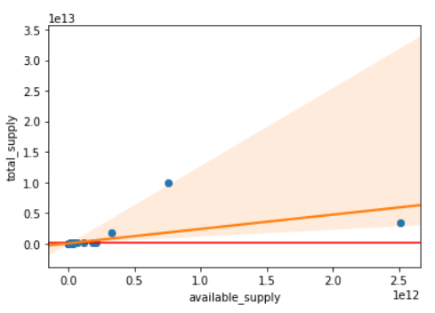

Slide 18
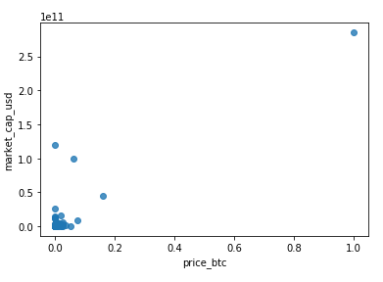
Scatterplot():These are made using the regplot() function.

Slide 19
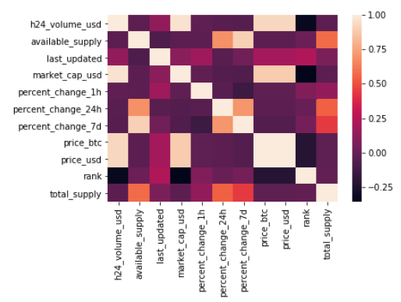
Heatmap():A heat map is a two-dimensional representation of data in which values are represented by colors.

Slide 20
Regression
Simple Linear Regression:
Multiple Linear Regression
Notes:
Simple Linear Regression
Multiple Linear Regression

Slide 21
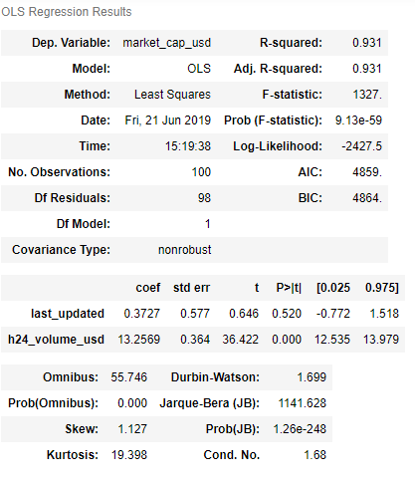
Summary(): It gives us the short document or section of a document of the data.

Slide 22
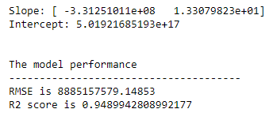
Accuracy():It refers to the closeness of a measured value to a standard or Known value.
Accuracy of the last_updated, h24_volume_usd and market_cap_usd: 94.89%
The RMSE and R2 score of the model is:

Slide 23
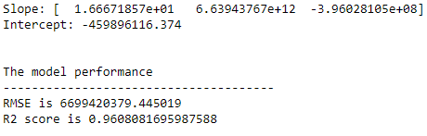
The accuracy of h24_volume_usd, price_btc, price_usd and market_cap_usd is :96.08%
The RMSE and R2 score values of the model is:

Slide 24
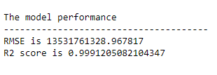
The accuracy of h24_volume_usd, available_supply, price_usd and total_supply is :99.9%
The RMSE and R2 score values of the model is:

Slide 25
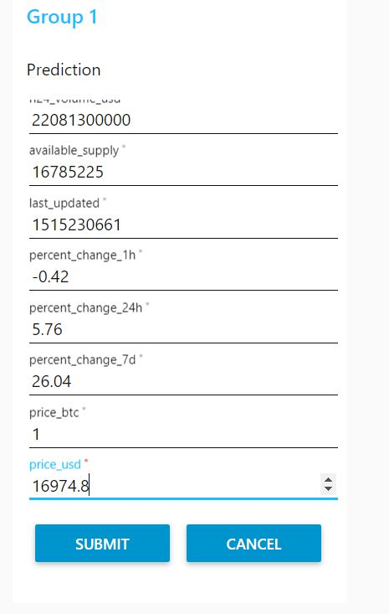
User Interface
Input

Slide 26
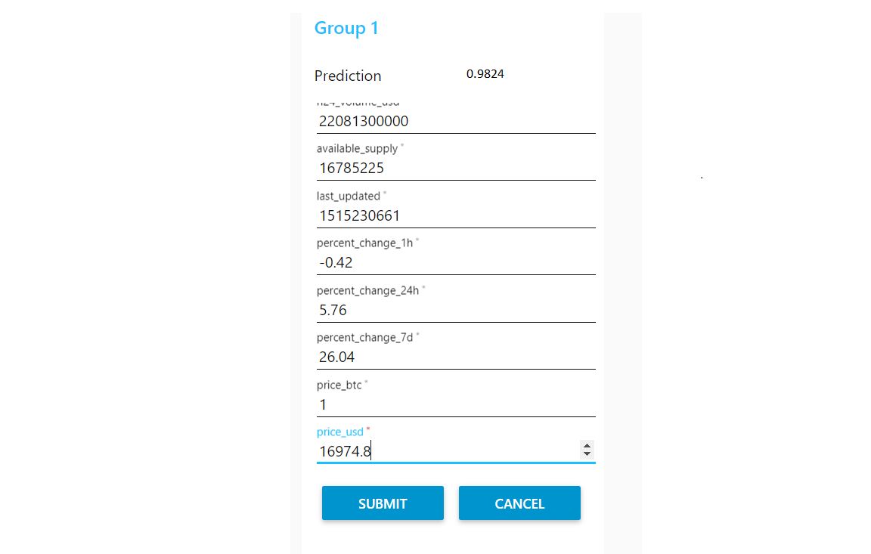
User Interface
Output

Slide 27
Conclusion

Slide 28
ThankYou

